Slide 1
DATA ANALYSIS AND
VISUALIZATION
TRIP ANALYSIS
“A STUDY OF UBER TRIP DATA”

Slide 2
Purpose of the analysis :
The purpose of the analysis is to examine Uber trip data to identify patterns and trends in ride-sharing activity. By analyzing the data, we aim to understand trip frequency across different times of the day and days of the week, as well as observe the geographical distribution of trips. This analysis can help provide insights into peak usage times, popular areas for rides, and potential areas for service improvement. Ultimately, the analysis will inform decision-making for operational efficiency and customer satisfaction.
Dataset used:
The analysis uses a dataset containing Uber trip data. The dataset includes the following columns:
Date/Time: The date and time when each trip took place.
Longitude: The longitude coordinates of the trip's pickup location.
Latitude: The latitude coordinates of the trip's pickup location.
Base: The base code associated with each trip, indicating the dispatch location or service hub.

Slide 3
Data preparation :
The data was read using pandas by loading the Uber trip data CSV file with the function pd.read_csv("uber.csv"). This function reads the file and loads the data into a DataFrame, a data structure provided by pandas.
The "Date/Time" column was converted to datetime format using the map(pd.to_datetime) function. This function applies the pd.to_datetime method to each element in the "Date/Time" column, converting the values to datetime objects. This conversion allows for easier manipulation and analysis of the data based on date and time.
After converting the "Date/Time" column to datetime format, new columns were extracted from it:
"Day": Extracted using .apply(lambda x: x.day), this column represents the day of the month for each trip.
"Weekday": Extracted using .apply(lambda x: x.weekday()), this column indicates the day of the week for each trip, with 0 representing Monday and 6 representing Sunday.
"Hour": Extracted using .apply(lambda x: x.hour), this column shows the hour of the day (in 24-hour format) when each trip occurred.
These new columns provide additional context for analyzing the trip data in terms of daily and hourly patterns.

Slide 4
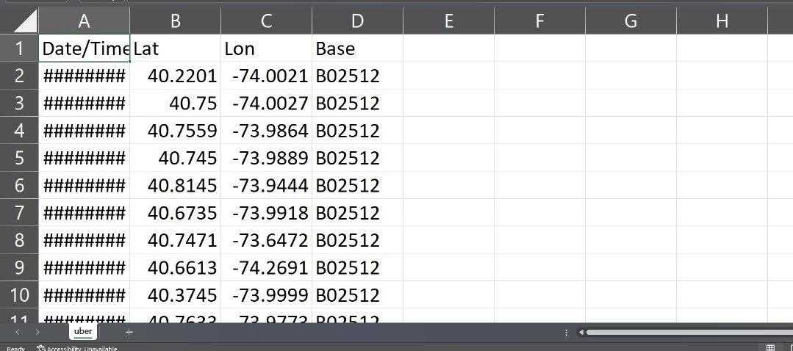
Data overview

Slide 5
Distribution of day and month :
The seaborn distribution plot (sns.distplot(data["Day"])) for the "Day" column visualizes the distribution of trips across different days of the month. The plot displays a histogram of trip frequencies for each day, with a curve representing the estimated density.
The plot can help identify which days of the month have higher or lower trip frequencies. For example, peaks in the plot might indicate particularly busy days for Uber, while troughs could suggest slower days. Interesting observations may include:
High Trip Frequency: Certain days may have notably higher trip frequencies, such as weekends or specific dates like the start or end of the month.
Low Trip Frequency: Other days may have lower trip frequencies, potentially indicating less demand for Uber services on those dates.
Consistency: A relatively even distribution across the month may suggest consistent demand for Uber services.
Overall, the plot provides insights into how trip demand varies throughout the month, which can inform scheduling and resource allocation for Uber's operations.

Slide 6
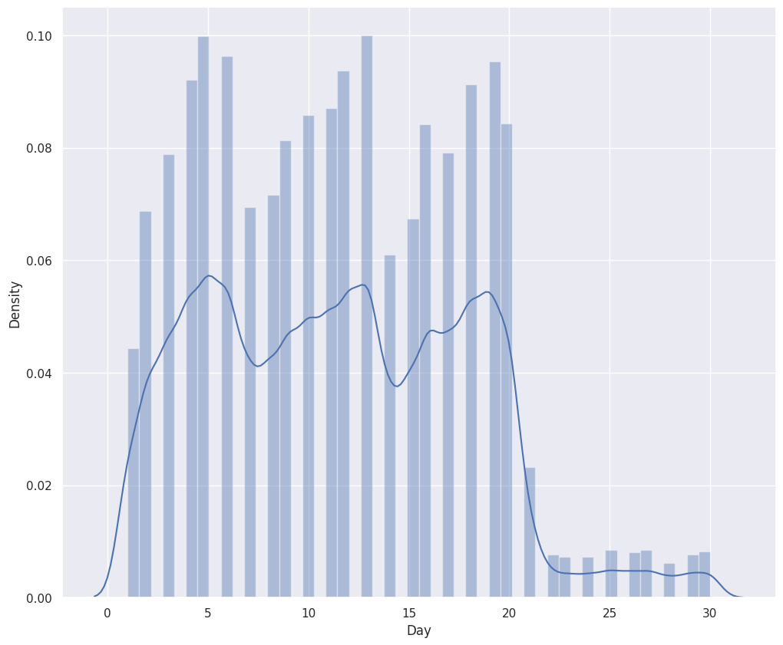

Slide 7
Distribution of hour of the day :
The seaborn distribution plot (`sns.distplot(data["Hour"])`) for the "Hour" column visualizes the distribution of trips across different hours of the day. The plot shows a histogram of trip frequencies for each hour, along with a curve representing the estimated density.
The plot can reveal trends in trip frequencies by hour, providing insights into peak and off-peak times for Uber services. Notable observations might include:
- Peak Hours: The plot may show clear peaks during certain hours, such as morning and evening rush hours, indicating higher demand for Uber rides during these times.
- Low Demand Hours: Certain hours, such as late at night or early in the morning, may show lower trip frequencies, suggesting reduced demand during these times.
- Consistent Patterns: Regular patterns, such as consistent peaks and troughs each day, can highlight standard commuting times or daily routines of users.
Overall, the distribution plot provides valuable information on the hourly usage patterns of Uber services, which can guide decisions on resource allocation and scheduling to meet user demand.

Slide 8
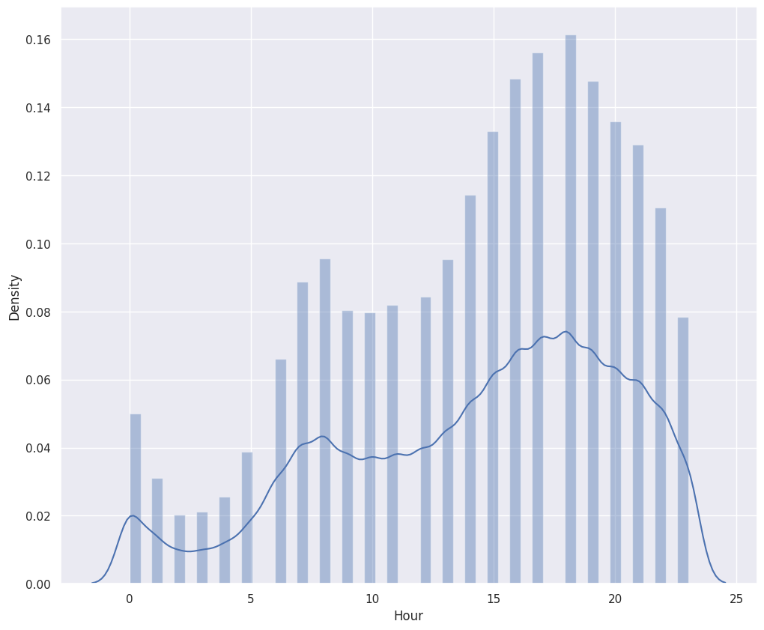

Slide 9
Distribution of day of the week :
The seaborn distribution plot (`sns.distplot(data["Weekday"])`) for the "Weekday" column visualizes the distribution of trips across different days of the week. The plot includes a histogram showing trip frequencies for each weekday, with a curve representing the estimated density.
Here's an explanation of the plot and significant observations:
- Weekday Labels: The "Weekday" column ranges from 0 (Monday) to 6 (Sunday), so the plot shows the distribution of trips for each day of the week.
- Busiest Days: Peaks in the plot indicate the days with the highest trip frequencies. These days are typically Friday and Saturday, reflecting the increased demand for rides during the weekend.
- Quieter Days: Troughs in the plot suggest days with lower trip frequencies. Monday and Tuesday may show lower demand compared to other days.
- Overall Trends: The plot may demonstrate a clear trend of increased trip frequencies toward the end of the week and on weekends, possibly due to leisure activities and nightlife.
In summary, the distribution plot provides insights into how trip demand varies throughout the week. This information can help Uber optimize its services by allocating more resources during peak days and times.

Slide 10
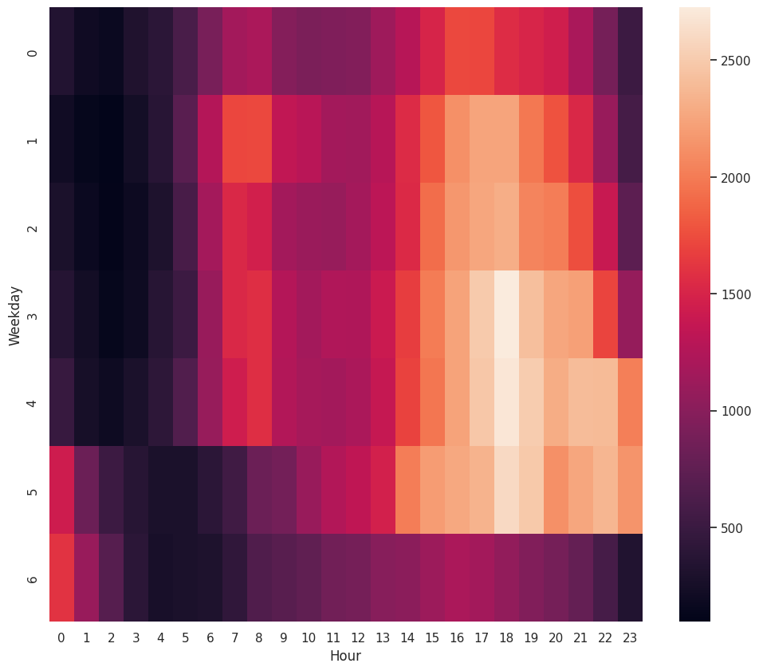
Heat map of trips by hour and weekday

Slide 11
Geographical visualization of trips :
The scatter plot (`data.plot(kind='scatter', x='Lon', y='Lat', alpha=0.4, s=data['Day'], label='Uber Trips', figsize=(12, 8), cmap=plt.get_cmap('jet'))`) visualizes the distribution of Uber trips across the city on a geographical map. Here's a description of the plot and the trips' distribution:
- Geographical Distribution: The plot maps trips based on their longitude (x-axis) and latitude (y-axis) coordinates. Each point on the map represents a trip's pickup location.
- Density and Opacity: The alpha value (`alpha=0.4`) controls the transparency of the points. Higher density areas of the map will appear darker due to the overlapping points.
- Trip Frequency: The size of the points (`s=data['Day']`) can represent different aspects of the data. In this case, it could represent the day of the month, which can indicate any patterns or preferences for trips on certain days.
- Color Mapping: The plot uses a colormap (`cmap=plt.get_cmap('jet')`) to represent different values visually, possibly indicating the magnitude of trips or the frequency of trips across the city.
- Hotspots: By observing areas with a high density of points, you can identify potential hotspots where there is a concentration of trips. These areas might include city centers, transportation hubs, or other busy locations.
Overall, the scatter plot provides a visual representation of how Uber trips are distributed across the city. It highlights key areas with higher ride demand, which can be useful for operational planning and optimizing service coverage.

Slide 12
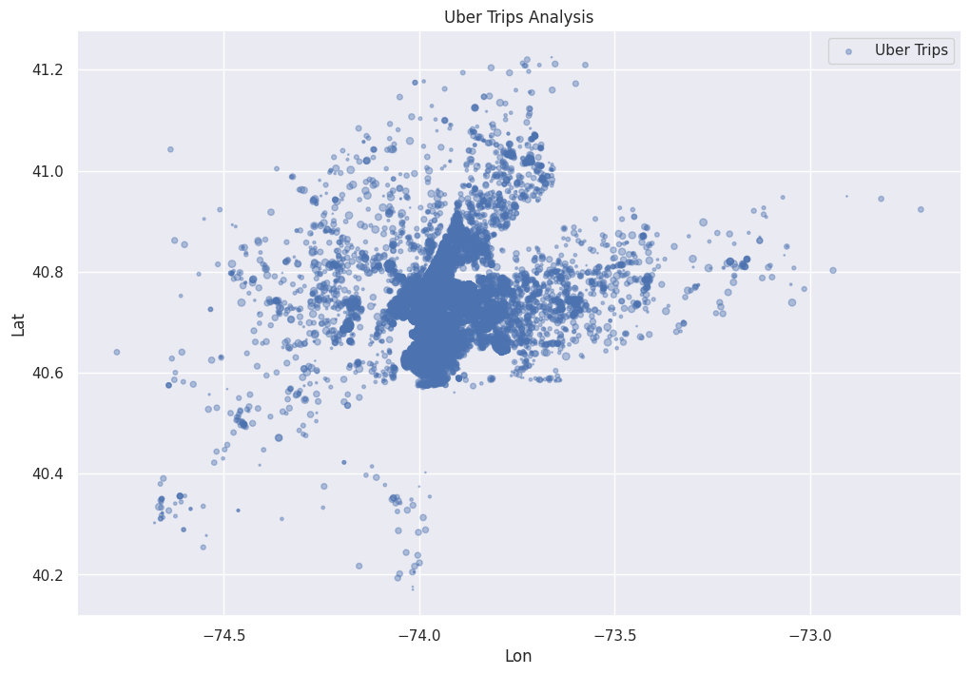

Slide 13
Conclusion :
Key Findings from the Analysis
Day of the Month Distribution:
The analysis showed varying trip frequencies across the month. Certain days may exhibit higher demand, particularly around weekends and specific dates such as the beginning or end of the month.
Hour of the Day Distribution:
There were clear peaks in trip frequencies during the morning and evening rush hours. This indicates higher demand for Uber rides during these commuting times.
Late-night hours showed lower trip frequencies, suggesting reduced demand during these times.
Day of the Week Distribution:
The data revealed that weekends, particularly Friday and Saturday, are the busiest days for Uber. There is a noticeable increase in trip demand as the week progresses.
Monday and Tuesday tend to have lower trip frequencies compared to other days.
Geographical Distribution of Trips:
The scatter plot illustrated the geographical distribution of trips across the city. High-density areas, or hotspots, were observed in city centers and areas with heavy traffic or popular destinations.
Patterns and Trends Observed
Demand Patterns: There is a clear pattern of increased demand during specific hours of the day, particularly during rush hours, and on weekends.
Geographical Hotspots: Certain areas within the city have higher concentrations of trips, possibly due to business districts, entertainment centers, or transportation hubs.
Implications for Uber's Operations
Resource Allocation: Uber can use these findings to allocate drivers and resources more efficiently during peak hours and on busy days to meet demand.
Service Optimization: Understanding geographical hotspots can help Uber optimize its service coverage and focus on high-demand areas.
Strategic Planning: The data can inform strategic decisions such as adjusting pricing, promotions, and driver incentives during peak times to manage demand and supply effectively.

Slide 14
Project by:
160122737111 : K.Abhiram
160122737118 : Md.Faizan.Farooqui
160122737121 : N.Venu Madhav

